Slide 1

SDL at Microsoft, A Brief History!
“One of the most important changes to make is making developers responsible for secure development.”
Rahul Goel: RA1911030010094
Rushil Saxena: RA1911030010119

Slide 2

What is SSDLC?
A process model used by organisations to build secure applications.
The process define how to integrate security into the software development process.
Stands for Secure Software Development Lifecycle
Systematic, multi-step process that streamlines software development from inception to release.

Slide 3
Importance of SSDLC
People want secure software.
Investor and business stakeholder interests.
Early bug detection is much more cost-effective.
Overall reduces risk to the business.
Data Protection.

Slide 4
Microsoft Steps IN!!
In the early 2000s, PCs were becoming increasingly common in the home and the internet was gaining more widespread use.
This led to a rise in malicious software looking to take advantage of users.
It became evident that protecting users from malicious software was going to take a fundamentally different approach to security

Slide 5
In 2004, Microsoft released a spiral model based software development process, which was initially proposed in 2002.
Also in 2002 Microsoft launched TwC, Trustworthy Computing based on watrerfall model to make sure latest softwares were secure enough
All this was done to help developers create applications or software while reducing security issues, resolving security vulnerabilities and even reducing development and maintenance costs.
This came to be known as Secure Development Lifecycle or simply as SDL at Microsoft.

Slide 6
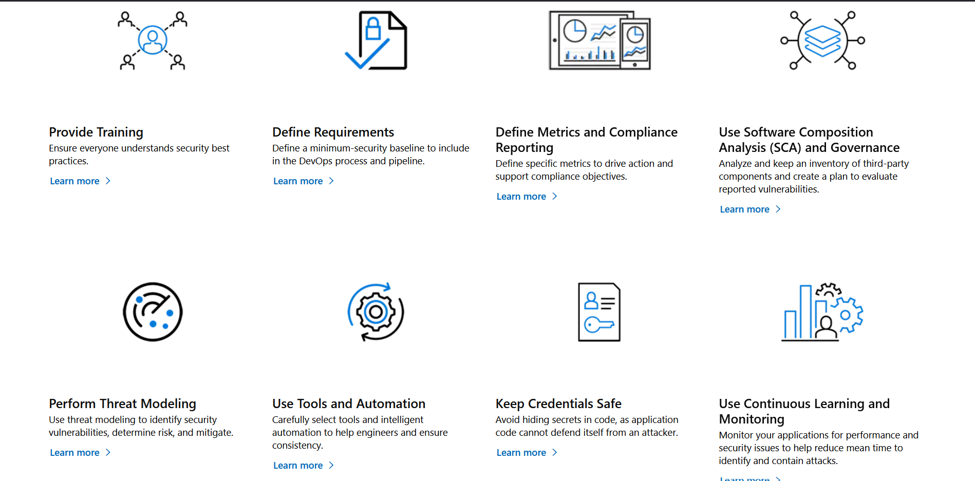
Phases/Practices of SDL

Slide 7
Methodology
Waterfall and Spiral model were initially used.
Later Agile Model was deployed considering the advancements and advantages
One of it being in agile method, we develop small amounts of code blocks which allows for the release of updated code much more quickly which wasn’t possible with waterfall and spiral model.

Slide 8
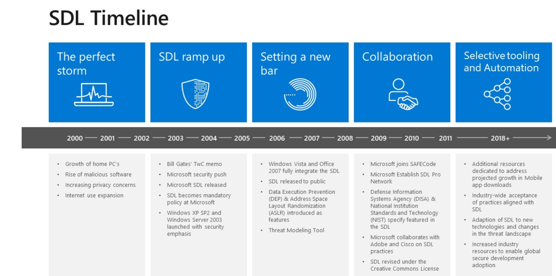
Microsoft SDL Timeline

Slide 9
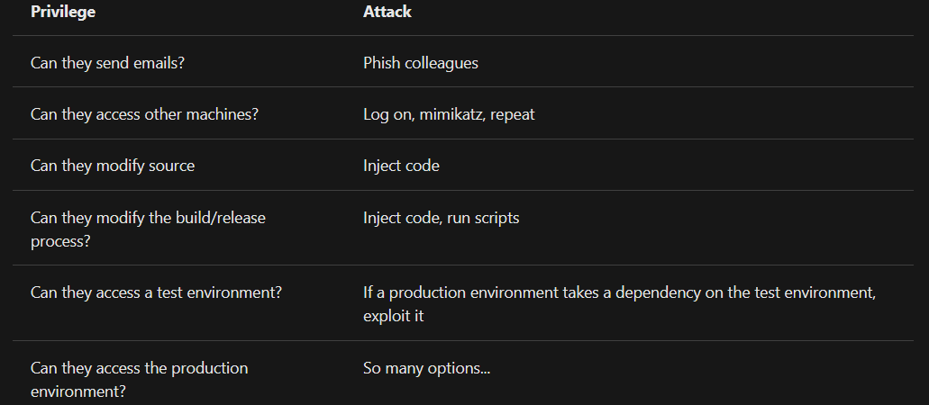
Attacking Options

Slide 10
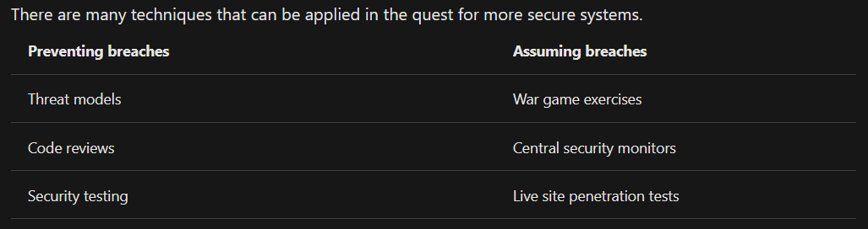
Secure Development
The mindset shift to a secure culture includes an important thinking about not only preventing breaches, but assuming them as well.
Every team should already have at least some practices in place for preventing breaches.
There are many free and commercial tools to aid in static analysis and other security testing features.
Few Practices are discussed here

Slide 11
Conclusion
With all the latest threats and breaches, it is very important to have secure softwares.
Secure software means a greater customer trust.
Microsoft for over a decade has regularly practiced SDL and has learned a lot of lessons along the way.
With the rise of mobile, cloud computing, Internet of Things, artificial intelligence, etc, Microsoft has evolved and used latest technologies to give as secure software as possible in the current internet and technology based society

Slide 12

THANK YOU!
Topic:
SDL at Microsoft, A Brief History!

